Slide 1
Accessing Data through API
David Stephens

Slide 2
Overview
Today we will focus on accessing data by making API calls.
We will retrieve data from storage systems using API endpoints.
Objectives:
Have an understanding of what an API is
Be able to read and understand an API documentation for ease of interaction
Comfortably retrieve data from a source using available API endpoints
Be able to handle responses from an API and perform analysis

Slide 3
API
API is an acronym for Application Programming Interface.
Analogous to a waiter/ess in a restaurant.
It is an interface that allows you to communicate with a server. There are a lot of communications that can be done between you as a client and the server. These set of communications are known as Methods (GET, POST, PUT, DELETE).
Why? (Would companies create an API)
If open to public, can help to solve solutions (think of data science competitions)
Monetize data
Unintended consequences
Where? (e.g. On Github)
https://github.com/public-apis/public-apis

Slide 4
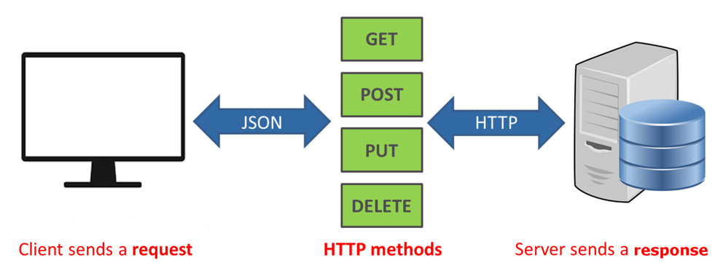
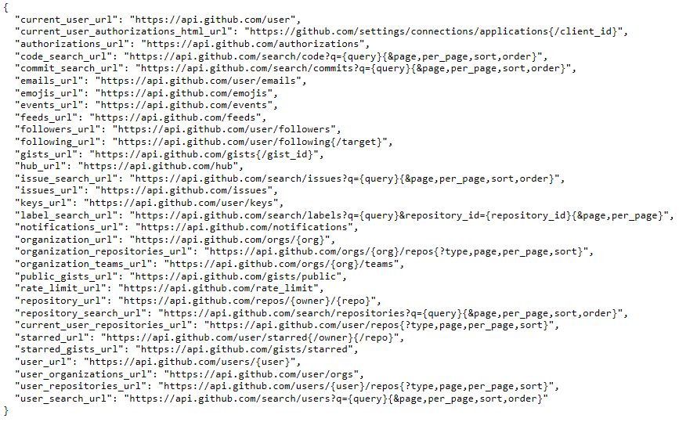
API Structure I
APIs are just like the web urls you are used to seeing. The only difference is that they cannot be used as one, but as was intended; as arguments in an API wrapper or requests libraries.
Each url is a request and the data sent back is a response. Most APIs return data in JSON formats.

Slide 5
API Structure II
Endpoints:
This is the url you are requesting for. It is the starting point of the API you are requesting from. Like the Github API above, what is shown is the root-endpoint (https://github.com/public-apis/public-apis)
Methods:
The method is the type of request you send to the server. It gives meaning to the endpoint and the request you are making.
GET : This is used for retrieving data from the server. This is mostly what we will be doing in this tutorial as we seek to pull data from platforms
POST : This is used to create new data in the database
PUT : This is used to update data on the database
DELETE : This is used to delete data from a database

Slide 6
API Structure III
Headers:
Headers are used to provide information to both the client and server. It can be used for many purposes, such as authentication and providing information about the body content.
Data:
The data (sometimes called “body” or “message”) contains information you want to be sent to the server. This option is only used with e.g. POST, PUT or DELETE requests.

Slide 7
API Workings
APIs can be documented randomly. You are hoping that they are well-documented and contains a Python wrapper.
API Wrapper:
An API wrapper is simply a python library that is custom developed for accessing a particular API. Just like other python libraries, they have packages in them that allows users perform a variety of operations as suited for the platform in question (see Twitter wrapper).
Request:
Now we know that we can make use of API tools such as wrappers to access an API terminal. However, you won't always have an already made custom tool, hence you need to find an alternative to requesting data from an API.
This is where the Requests library comes in.

Slide 8
API Documentation
This is like an user manual on what type of resources can be accessed through the API, how to access them (what methods to call or parameters to use) and tells you of the do(s) and don'ts of using the API.
Typically, the documentation will show you a sample response for any of the available methods. That is, it will tell what type of data is returned e.g, JSON, and what a typical format looks like. This is so you can be sure of what you need and how to retrieve them.
Coinbase, last fm examples.
Notes on documentation:
API Keys: An API key is sometimes required when you need to perform some special operations on user accounts. An example will be sending a Bitcoin on the Coinbase platform. To get an API Key, some providers will require you to create an account. Note it is information sensitive so store properly. (Handshake)
Rate Limits: Usually, the API provider will limit the amount of calls/requests made on the server per second. This is to avoid causing problems on the server due to multiple requests and overloading. You should restrict the rate of calls/request to avoid being banned from accessing the service.

